Slide 1
Bio& 242, Human A&P 2:
Unit 1/Lecture 3

Slide 2
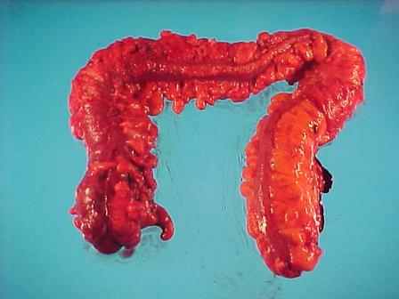
Anatomy of the Large Intestine
The large intestine (colon) extends from the ileocecal sphincter to the anus.
Its subdivisions include the cecum, colon, rectum, and anal canal.
Hanging inferior to the cecum is the
appendix.
  Inflammation of the appendix is
  called appendicitis.
  A ruptured appendix can
  result in gangrene or peritonitis,
  which can be life-threatening
  conditions.

Slide 3
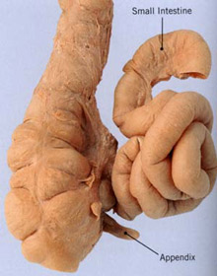
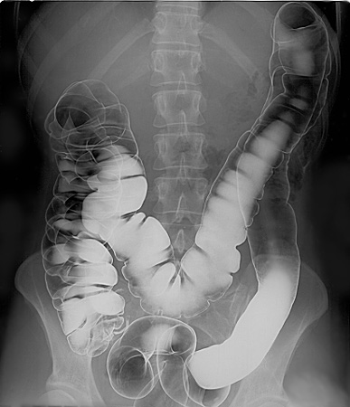

Slide 4
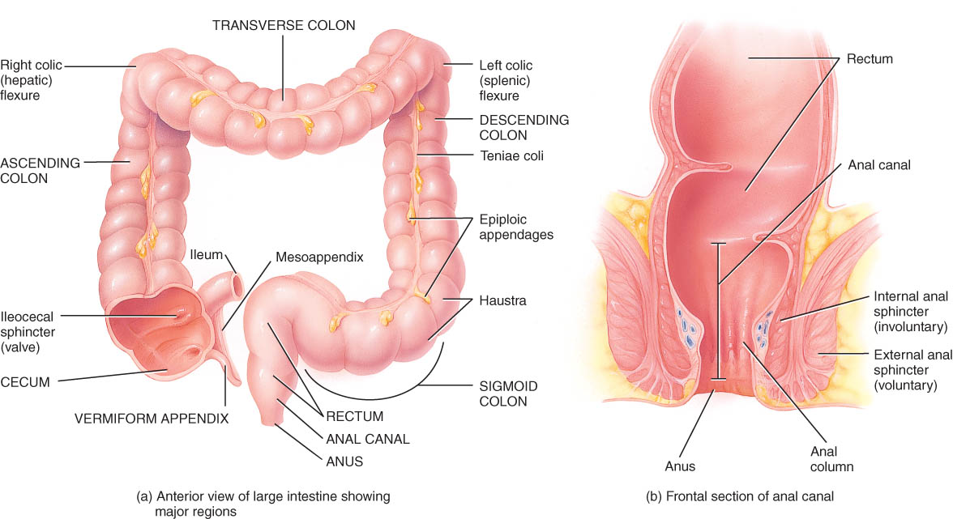
Anatomy of Large Intestine
5 feet long by 2½ inches in diameter
Ascending & descending colon are retroperitoneal
Rectum = last 8 inches of GI tract anterior to the sacrum & coccyx
Anal canal = last 1 inch of GI tract
  internal sphincter----smooth muscle & involuntary
  external sphincter----skeletal muscle & voluntary control

Slide 5
Mechanical Digestion in Large Intestine
Mechanical movements of the large intestine include haustral churning, peristalsis, and mass peristalsis.
Peristaltic waves (3 to 12 contractions/minute)
  haustral churning----relaxed pouches are filled from below by muscular contractions (elevator)
  gastroilial reflex = when stomach is full, gastrin hormone relaxes ileocecal sphincter so small intestine will empty and make room
  gastrocolic reflex = when stomach fills, a strong peristaltic wave moves contents of transverse colon into rectum by Mass peristalsis

Slide 6
Chemical Digestion in Large Intestine
No enzymes are secreted only mucous
Bacteria ferment
  undigested carbohydrates into carbon dioxide & methane gas
  undigested proteins into simpler substances (indoles)----odor
  turn bilirubin into simpler substances that produce color
Bacteria produce vitamin K and B in colon
Converts chyme into feces

Slide 7
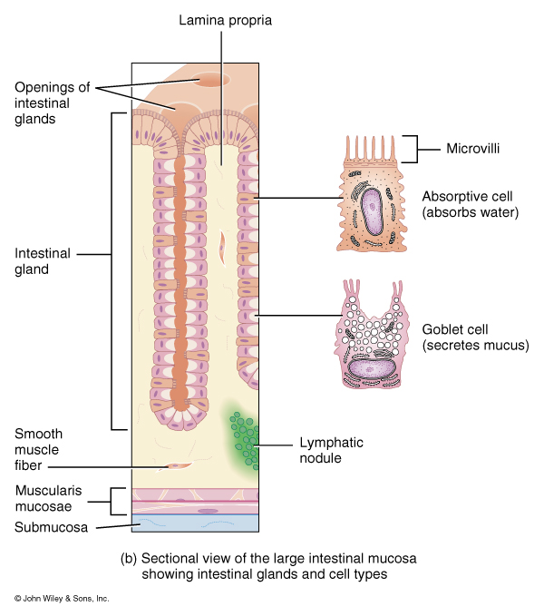
Functions of the Large intestinal Mucosa
Goblet cells: create mucus that lubricates colon and protects mucosa.
Absortive cells: Maintains water balance, solidifies feces, absorbs vitamins and some ions

Slide 8
Absorption & Feces Formation in the Large Intestine
Some electrolytes---Na+ and Cl-
After 3 to 10 hours, 90% of H2O has been removed from chyme
Feces are semisolid by time reaches transverse colon
Feces = dead epithelial cells, undigested food such as cellulose, bacteria (live & dead)

Slide 9
Absorption and Feces Formation in the Large Intestine
The large intestine absorbs water, electrolytes, and some vitamins.
Feces consist of water, inorganic salts, sloughed-off epithelial cells, bacteria, products of bacterial decomposition, and undigested parts of food.
Although most water absorption occurs in the small intestine, the large intestine absorbs enough to make it an important organ in maintaining the body’s water balance.

Slide 10
Defecation Reflex
The elimination of feces from the rectum is called defecation.
Defecation is a reflex action aided by voluntary contractions of the diaphragm and abdominal muscles. The external anal sphincter can be voluntarily controlled (except in infants) to allow or postpone defecation.

Slide 11
Defecation
Gastrocolic reflex moves feces into rectum
Stretch receptors signal sacral spinal cord
Parasympathetic nerves contract muscles of rectum & relax internal anal sphincter
External sphincter is voluntarily controlled

Slide 12
Defecation Problems
Diarrhea = chyme passes too quickly through intestine
  H₂0 not reabsorbed
Constipation--decreased intestinal motility
  too much water is reabsorbed
  remedy = fiber, exercise and water
Clinical Concerns
Colonoscoy is the visual examination of the lining of the colon using an elongated, flexible, fiberoptic endoscope.
Occult blood test is to screen for colorectal cancer.

Slide 13
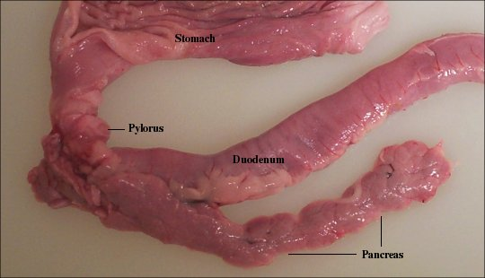
PANCREAS
The pancreas is divided into a head, body, and tail and is connected to the duodenum via the pancreatic duct (duct of Wirsung) and accessory duct (duct of Santorini).
Pancreatic islets (islets of Langerhans) secrete hormones and acini secrete a mixture of fluid and digestive enzymes called pancreatic juice.

Slide 14
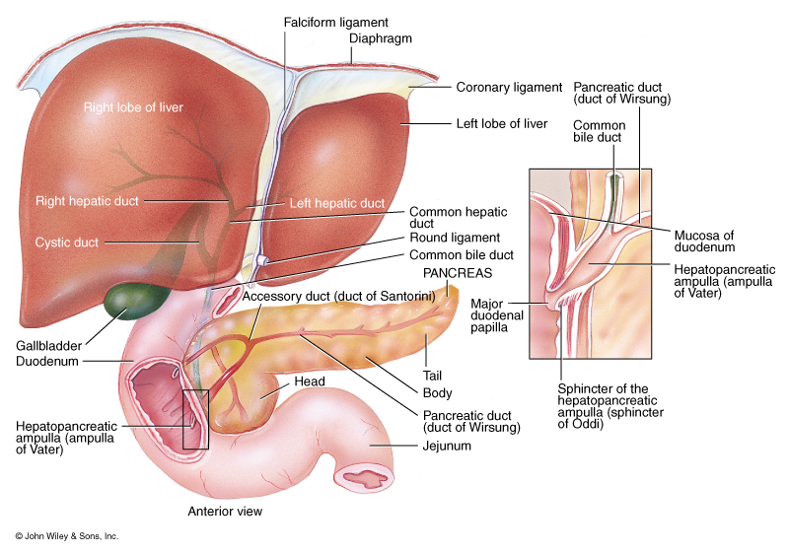
Accessory organs of the GI Tract
Pancreas:
Produces 1.2L to 1.5L of pancreatic juices daily.
Pancreatic juice consists of a bicarbonate solution containing salts and digestive enzymes.
Bicarbonate helps buffer acidic chyme from the stomach

Slide 15
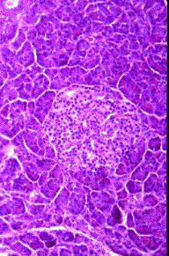
Histology of the Pancreas
Acinar cells: Secrete pancreatic juice, a mixture of bicarbonate fluid and digestive enzymes.
Islet of Langerhans:
Alpha cells- glucagon
Beta cells- insulin
Delta cells- somatostatin
F-cells- pancreatic polypeptide
Acini
Islet of Langerhans

Slide 16
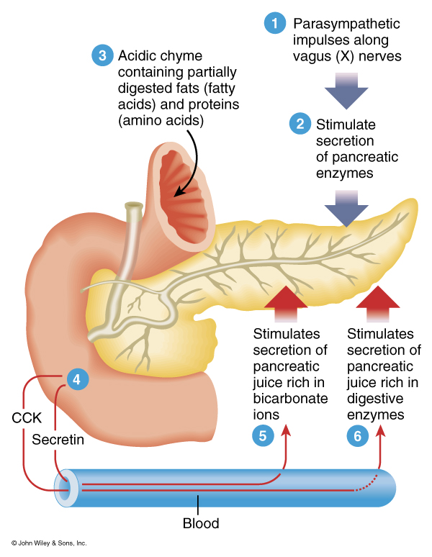
Neural and Hormonal Control of the Pancreas
Secretin:
  acidity in intestine causes increased sodium bicarbonate release
GIP:
  fatty acids & sugar causes increased insulin release
CCK:
  fats and proteins cause increased digestive enzyme release

Slide 17
LIVER AND GALLBLADDER
The liver is the heaviest gland in the body and the second largest organ in the body after the skin.
Anatomy of the Liver and Gallbladder
The liver is divisible into left and right lobes, separated by the falciform ligament. Associated with the right lobe are the caudate and quadrate lobes.
The gallbladder is a sac located in a depression on the posterior surface of the liver.

Slide 18
Histology of the Liver
The lobes of the liver are made up of lobules that contain hepatic cells (liver cells or hepatocytes), sinusoids, stellate reticuloendothelial (Kupffer’s) cells, and a central vein.
Bile is secreted by hepatocytes.
Bile passes into bile canaliculi to bile ducts to the right and left hepatic ducts which unite to form the common hepatic duct.
Common hepatic duct joins the cystic duct to form the common bile duct which enters the hepatopancreatic ampulla.

Slide 19
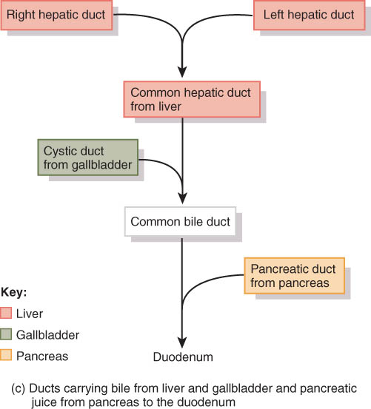
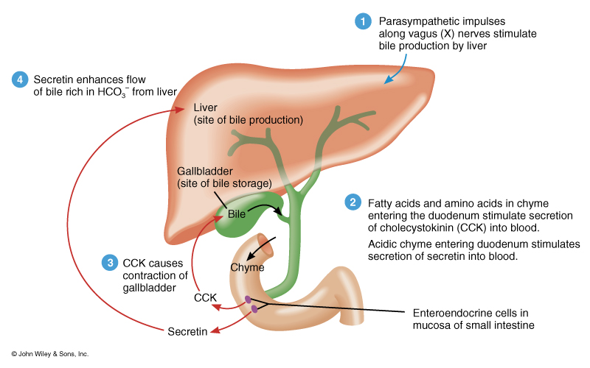
Pathway of Bile Secretion
Bile capillaries
Hepatic ducts connect to form common hepatic duct
Cystic duct from gallbladder & common hepatic duct join to form common bile duct
Common bile duct & pancreatic duct empty into duodenum

Slide 20
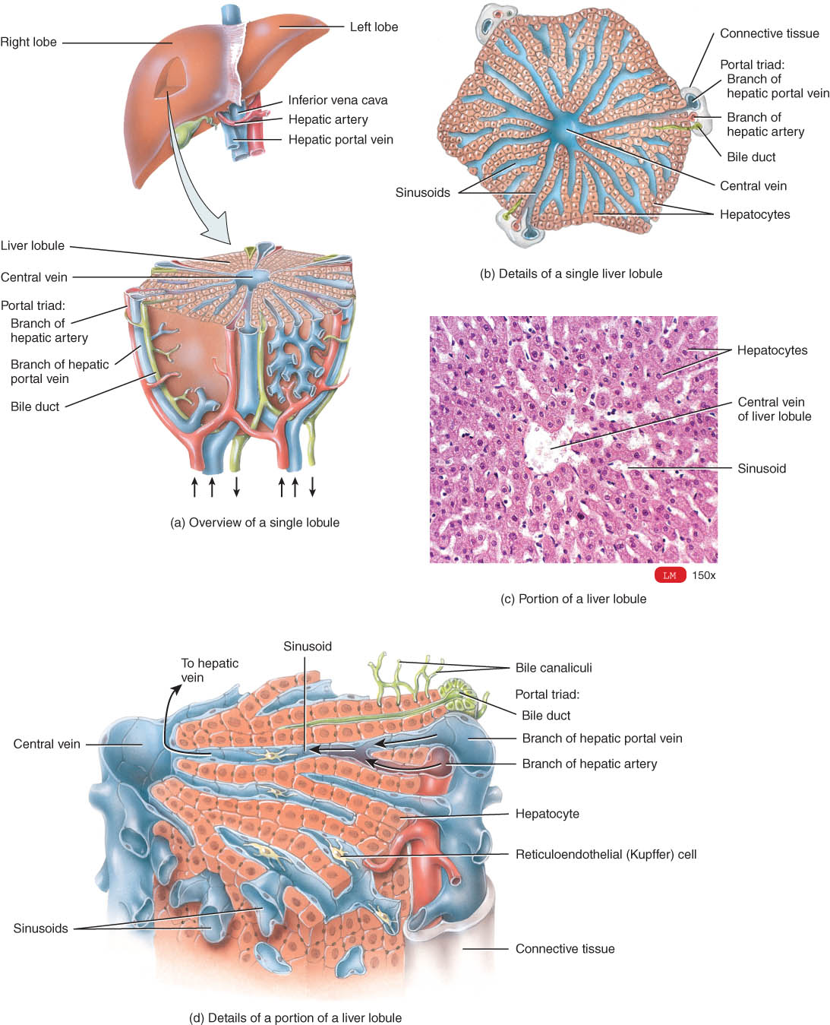
Accessory organs of the GI Tract
Liver:
Produces .8L to 1.0L of bile per day
  yellow-green in color & pH 7.6 to 8.6
Components
  water & cholesterol
  bile salts = Na & K salts of bile acids
  bile pigments (bilirubin) from hemoglobin molecule
    globin = a reuseable protein
    heme = broken down into iron and bilirubin

Slide 21
Bile - Overview
Hepatic cells (hepatocytes) produce bile that is transported by a duct system to the gallbladder for concentration and temporary storage.
Bile is partially an excretory product (containing components of worn-out red blood cells) and partially a digestive secretion.
Bile’s contribution to digestion is the emulsification of triglycerides.
The fusion of individual crystals of cholesterol is the beginning of 95% of all gallstones. Gallstones can cause obstruction to the outflow of bile in any portion of the duct system. Treatment of gallstones consists of using gallstone-dissolving drugs, lithotripsy, or surgery.

Slide 22
Bile - Overview
The liver also functions in carbohydrate, lipid, and protein metabolism; removal of drugs and hormones from the blood; excretion of bilirubin; synthesis of bile salts; storage of vitamins and minerals; phagocytosis; and activation of vitamin D.
In a liver biopsy a sample of living liver tissue is removed to diagnose a number of disorders.

Slide 23
Major Functions of the liver
Carbohydrate metabolism: maintains blood sugar levels.
a. Low Sugars levels: (control- glucagon)
glycogenolysis glycogen > glucose
b. High sugars levels: (control- insulin)
glycogenesis glucose > glycogen
Lipid metabolism
a. Produce fats: lipogenesis
b. Break down fats: lipolysis, beta oxidation
c. Synthesize cholesterol
d. Stores triglycerides

Slide 24
Major Functions of the Liver
Protein metabolism:
a. Synthesize most plasma proteins such as clotting proteins
b. Deaminate amino acid: remove NH2
Processes drugs, hormones, and alcohol
Excretes bilirubin (derived from the heme unit of recycled red blood cells)
Storage of Vitamins (A, B12, D, E, and K) and iron
Phagocytosis of aged red and white blood cells and some bacteria by Kupffer’s (reticuloendothelial) cells
Activation of Vitamin D
Stores iron and copper

Slide 25
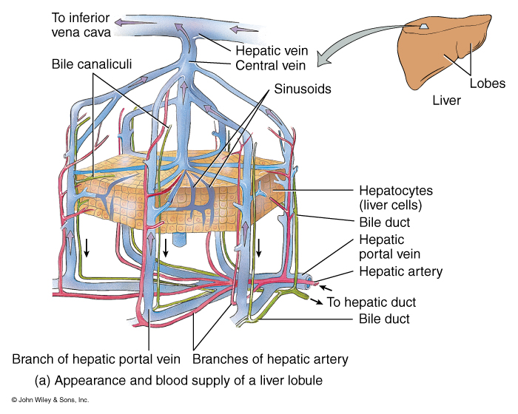
Lobule: The Functional Unit of the Liver

Slide 26
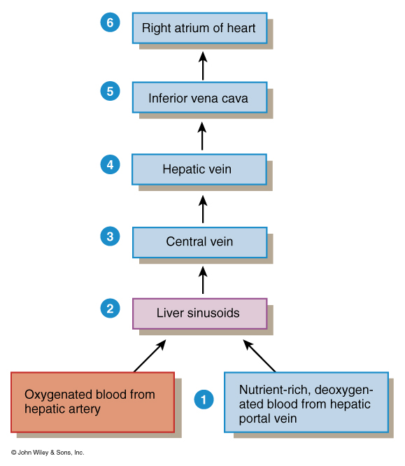
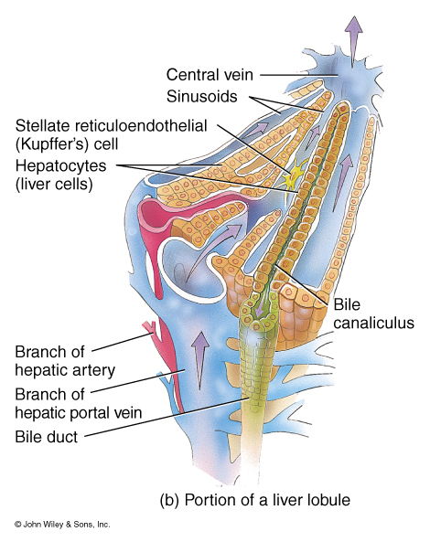
Hepatic Blood and
Lobular Structure

Slide 27
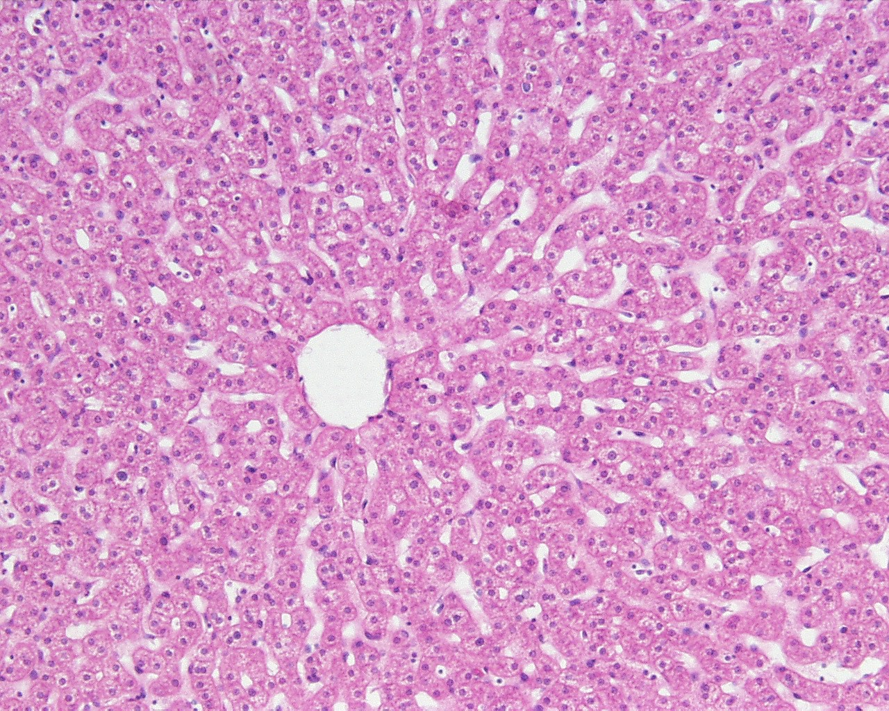
Histology of a lobule demonstrating the central vein

Slide 28
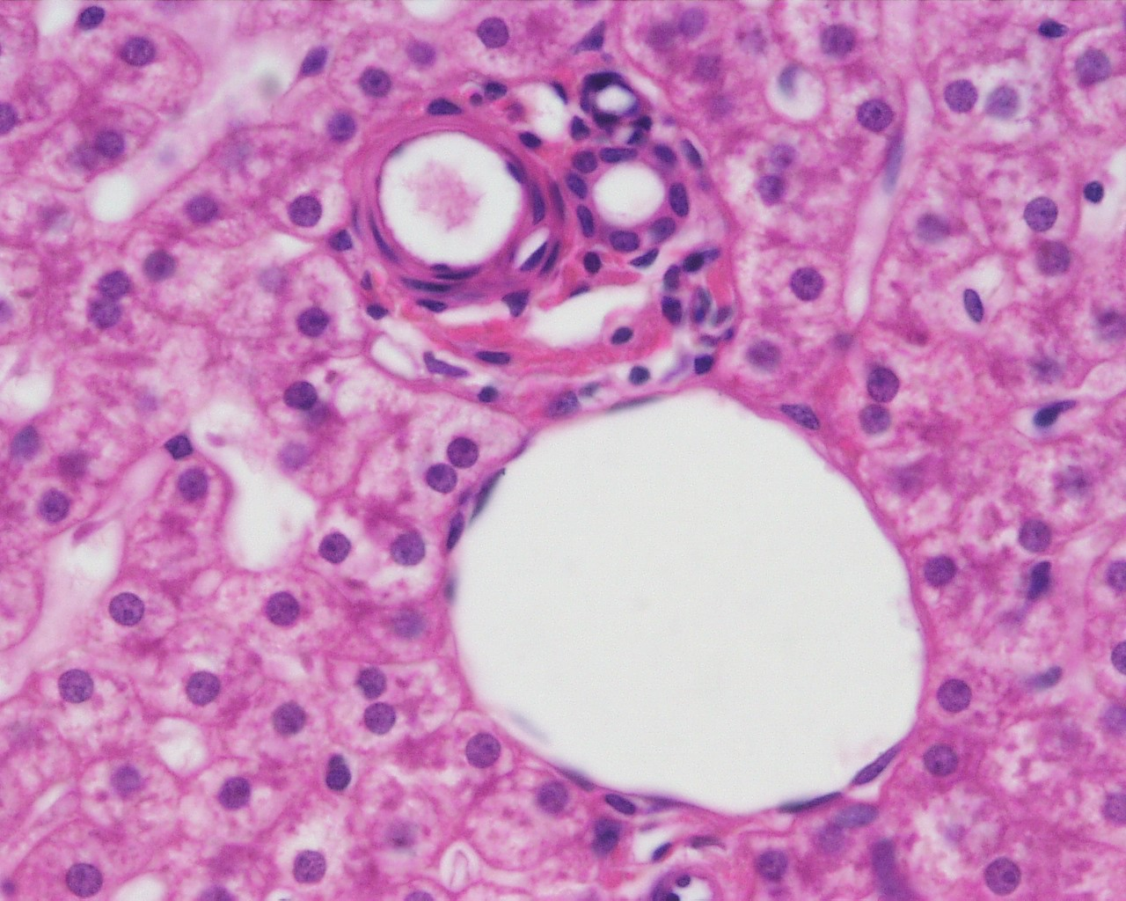
Histology of a lobule demonstrating the hepatic triad

